Slide 1
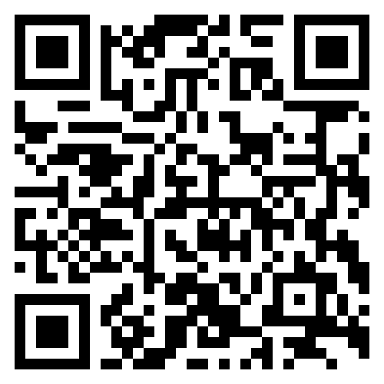



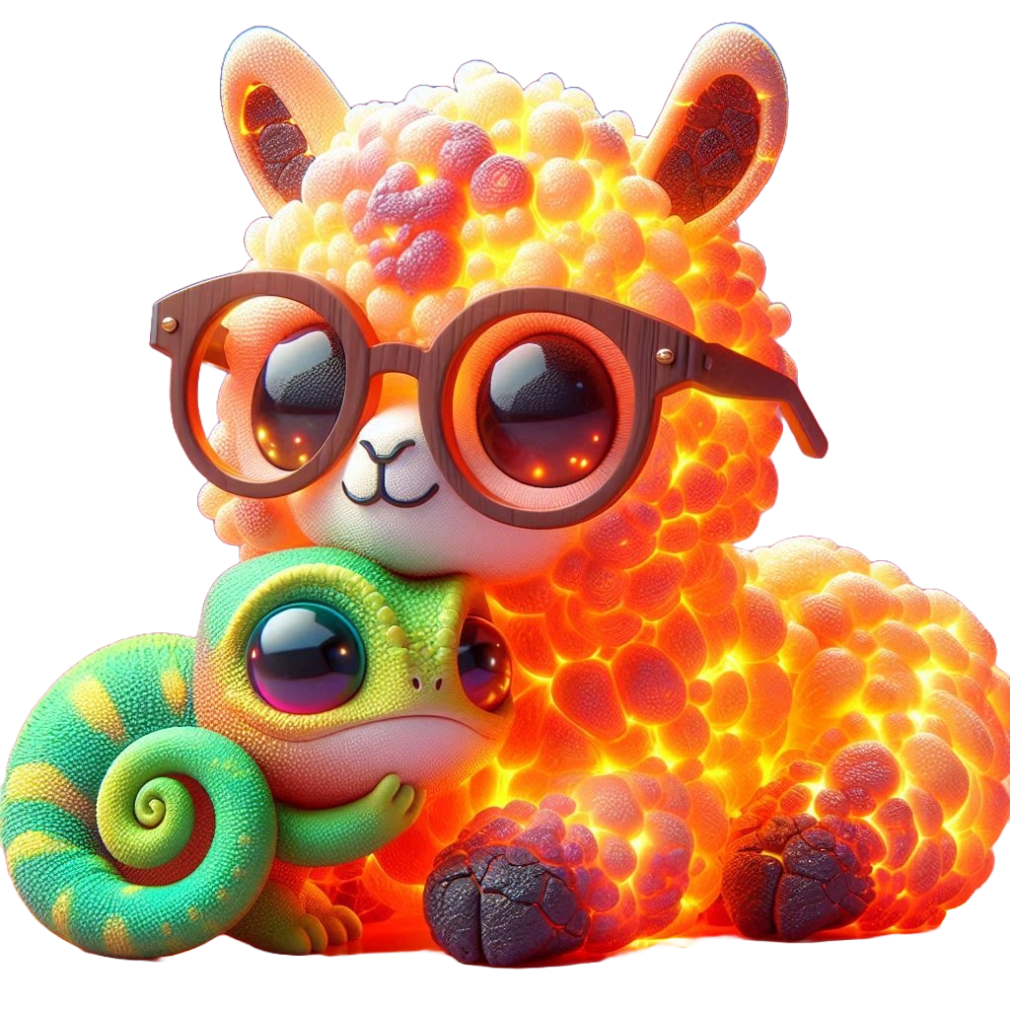
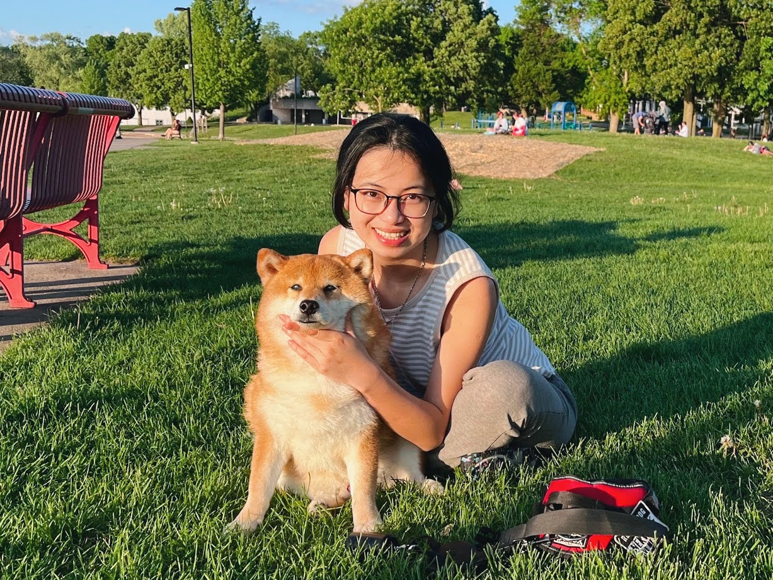
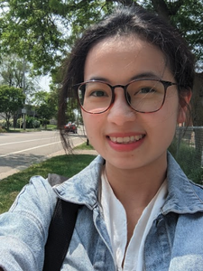

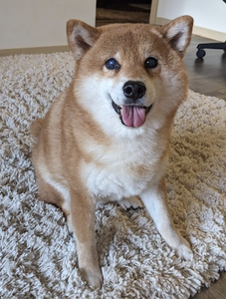
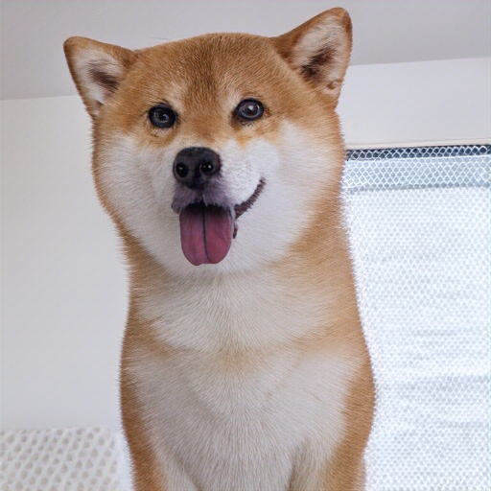
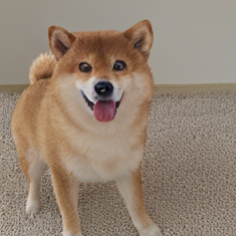
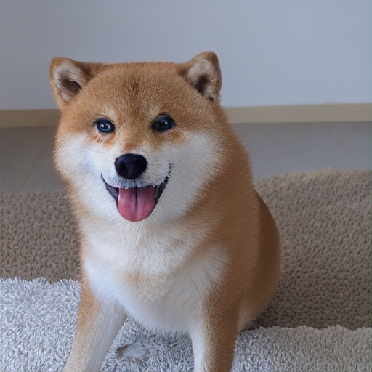
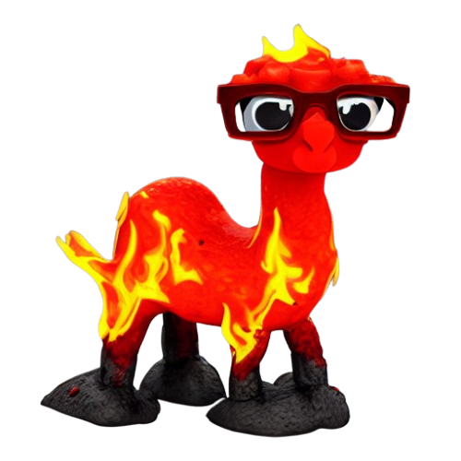
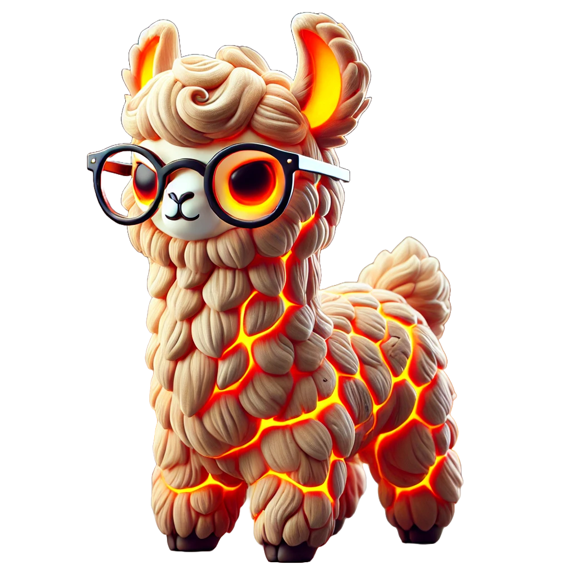
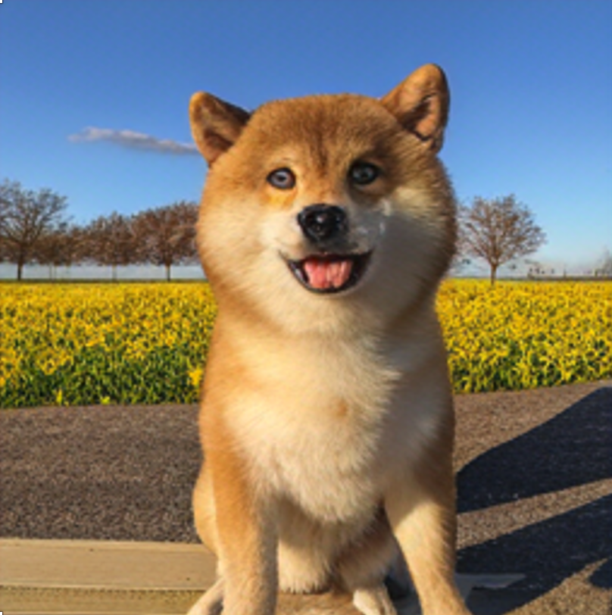

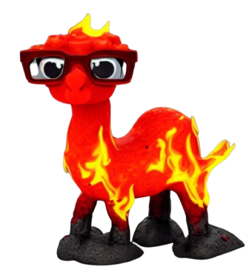

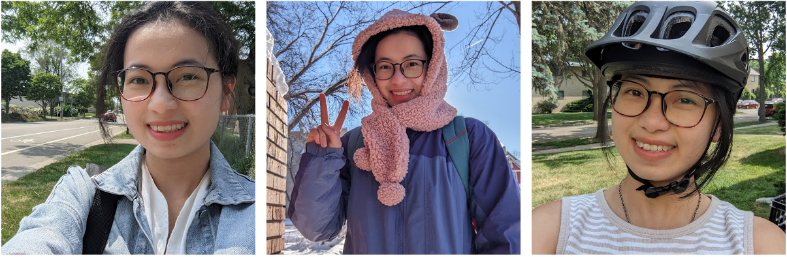
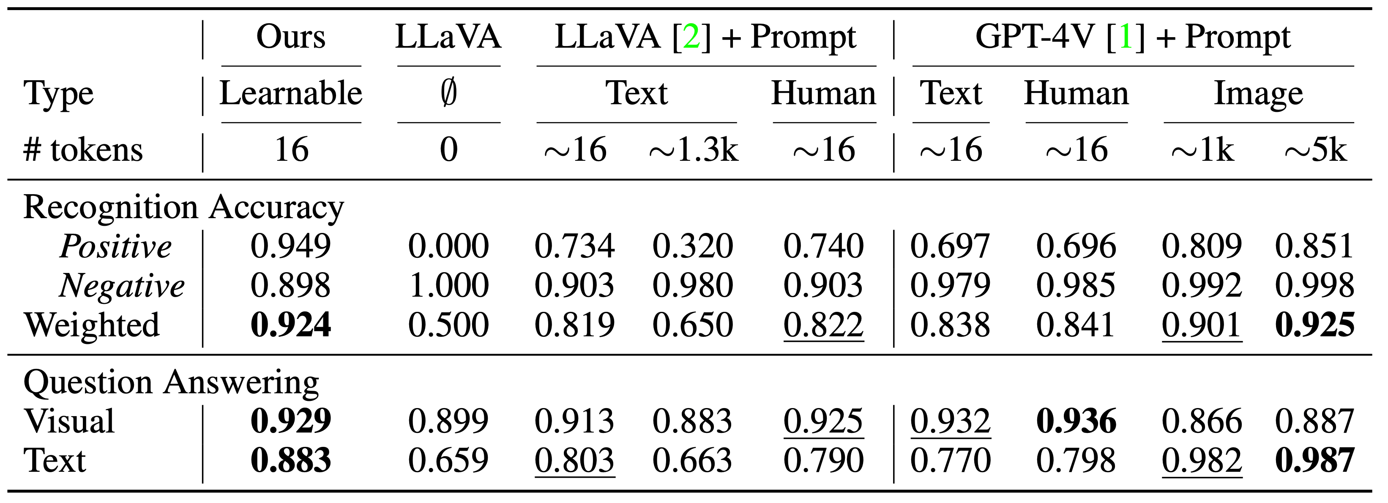
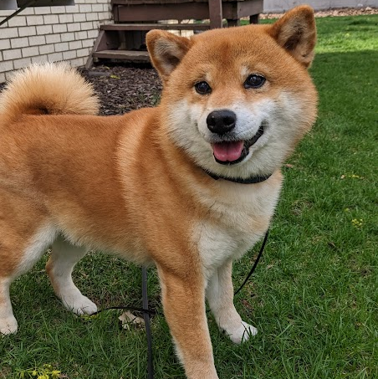
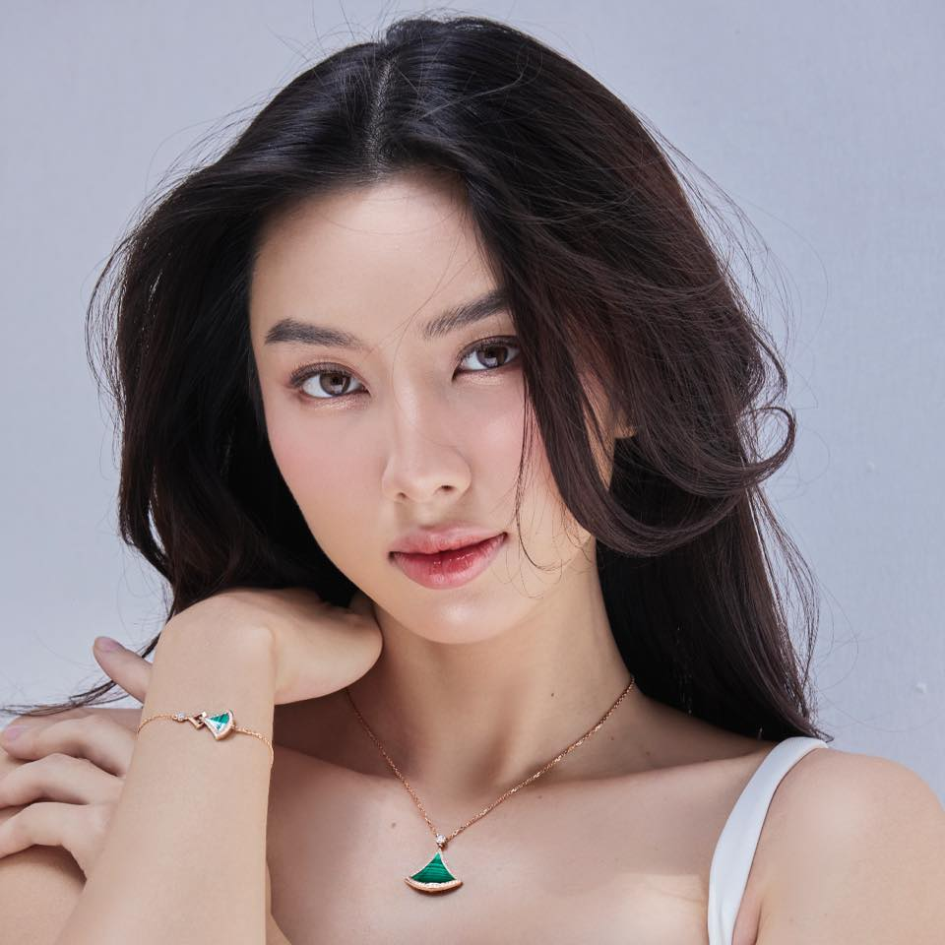

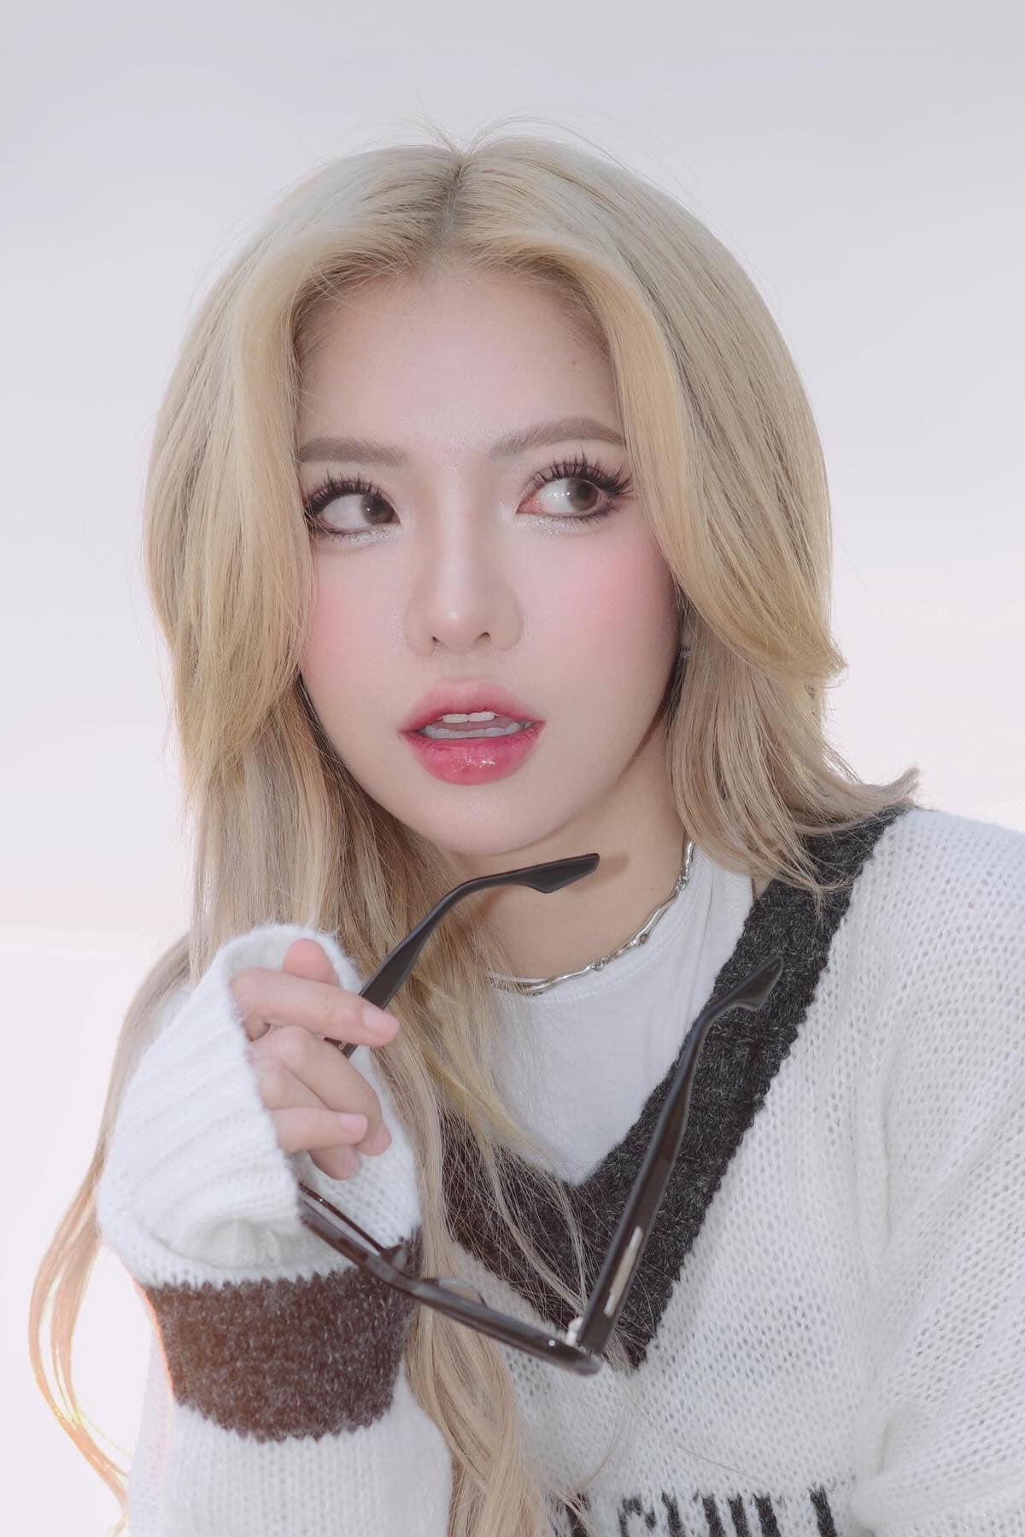
Yo'LLaVA: Your Personalized Language and Vision Assistant Thao Nguyen, Haotian Liu, Yuheng Li, Mu Cai, Utkarsh Ojha, Yong Jae Lee
Motivation
“What can you see in this photo?”
What’s Next?
Prompting
Extend to more modality!
(Now: Focus on image generation)
<thao> is a person with long, dark hair, often seen wearing comfortable outfits.
only need
3-5 images!
Learnable Prompt
<bo>
Could you generate photos of <bo>?
<thao> is
<token₁><token₂>...<token_{k}>.
<thao>
Yes! Here are generated photos of <bo>.
Training Pipeline
AI that understand “you”
I see a person and a dog.
The person is sitting on the grass...
Ahh, can you generate photos of <bo> but with sunflowers?
Sure, here are generated photos of <bo> with sunflowers.
I can see <thao> and <bo> in the photo.
They are sitting on the grass in a park, enjoying a beautiful day. <thao> is holding <bo>, and they both seem to be having a great time together.
Data Creation
(1) Basic Q&A
Auto-generated ~ No manual labelling needed!
Q: What is <thao> hair color?
A: <thao>’s hair color is dark.
Yo’LLaVA uses fewer tokens
while more effectively encode the visual attributes
compared to strong prompting baselines (i.e. GPT-4V)
(2) Positive Recognition
Q: Is <thao> in this photo?
A: Yes, <thao> is in this photo.
(3) Negative Recognition
...
...
Easy negative
Hard negative
Q: Is <thao> in this image?
A: <thao> is not in the image.

